Slide 1
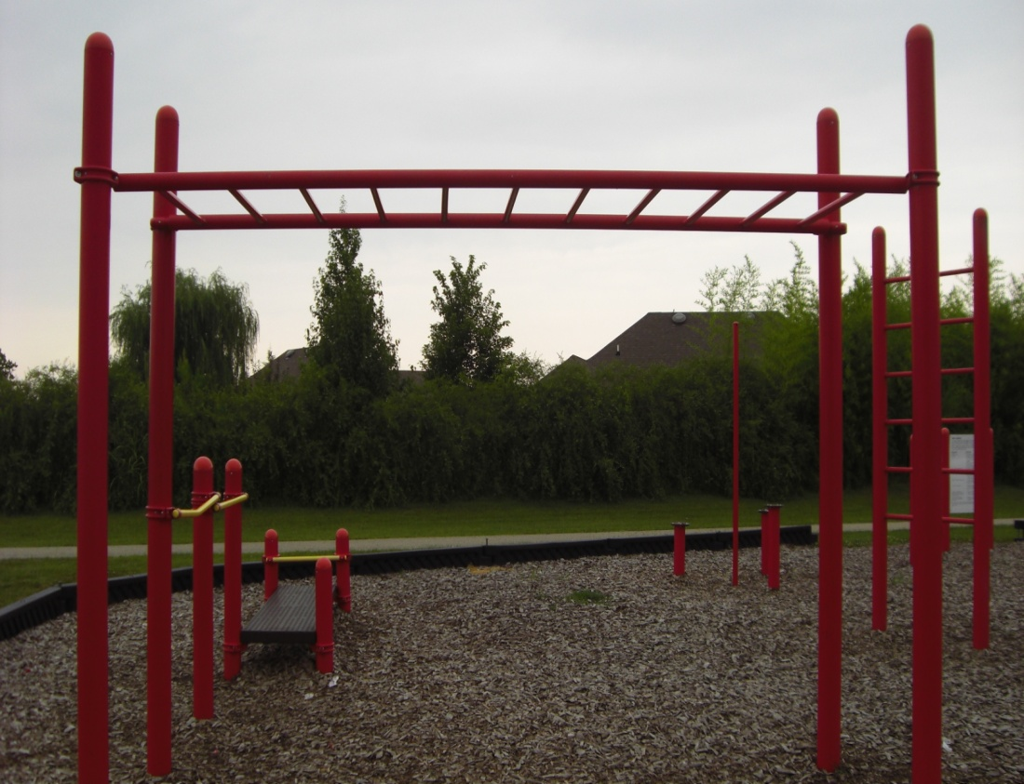
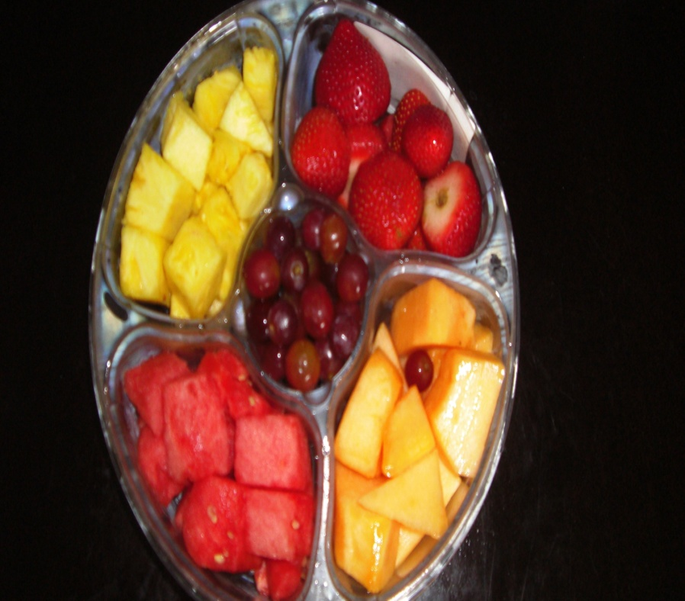
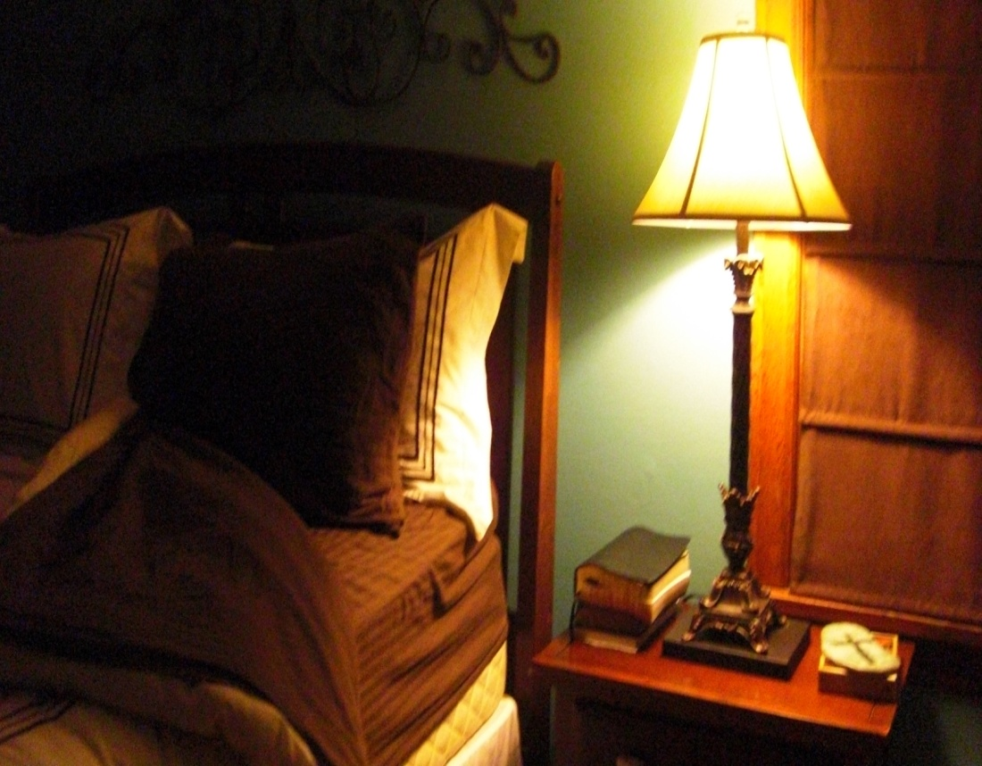
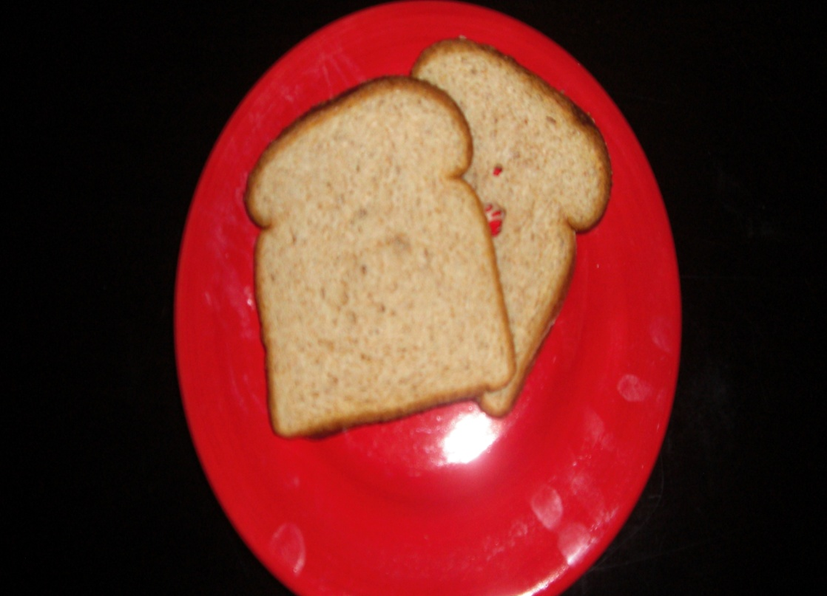
Are You Living A Healthy Lifestyle? Created by: Natalie Cates

Slide 2
Standards
Grade 5 Standard 4 - Health: The student will understand the relationship of physical activity and rest to healthy living. 4.1 explain the importance of participation in the recommended one hour of daily physical activity; 4.2 identify personal physical activity goals needed to achieve overall wellness;
Grade 5 Standard 5 - Nutrition: The student will understand the relationship of nutrition to healthy living. 5.1 use the “My Pyramid” as a guide for choosing a variety of foods necessary for good health; 5.2 explain how personal health and body composition is influenced by balancing diet and physical exercise.

Slide 3
Directions
This game is similar to Jeopardy. Each student will get a “clicker” – a device that allows you to signal if you know an answer – if you know an answer to a question, press the button on the top of your clicker and you will get a chance to answer. To see if you got the right answer, click the right arrow button at the bottom of the screen. If you answer correctly, you get those points and will get to choose the next question. To go back to the game board from the answer slide, click the right arrow button. To go back to the question from the answer slide, click the left arrow button. To print your score card, hit the “Esc” button to exit the slide show, find the score card slide, click “file” and then “print” – select “current slide” before clicking “print” again. Write down any points you receive for answering correctly. Some questions are worth more points than others, so be sure to pay attention to that! At the end, the student with the most points wins. We will play more than once!

Slide 4
Score Card
Point Value Received ____
Point Value Received ____
Point Value Received ____
Point Value Received ____
Point Value Received ____
Point Value Received ____
Point Value Received ____
Point Value Received ____
Point Value Received ____
Point Value Received ____
Point Value Received ____
Point Value Received ____
Point Value Received ____
Point Value Received ____

Slide 5
Game Board
Nutrition Basics
Food
Groups
Fitness
Facts
Healthy Living
Balanced Diet
100
100
100
100
100
200
200
200
200
200
300
300
300
300
300
400
400
400
400
400

Slide 6
Question 1
Define junk food.

Slide 7
Answer 1
food or drinks that are high in calories, fats, or sugars, but have no real nutritional value

Slide 8
Question 2
How many food groups are in the USDA’s Food Pyramid?

Slide 9
Answer 2
six
(grains, vegetables, fruits, milk, meat & beans, oils)

Slide 10
Question 3
What is the daily recommended amount of physical activity?

Slide 11
Answer 3
one hour

Slide 12
Question 4
What are the two components of healthy living?

Slide 13
Answer 4
balanced diet and regular exercise

Slide 14
Question 5
At your age, how much milk should you drink each day?

Slide 15
Answer 5
three cups

Slide 16
Question 6
Which type of fat is considered “bad” fat?

Slide 17
Answer 6
saturated fat

Slide 18
Question 7
How many vegetables should you eat each day?

Slide 19
Answer 7
2.5 cups

Slide 20
Question 8
Define physical activity.

Slide 21
Answer 8
any activity that makes your body work harder than normal

Slide 22
Question 9
About how many hours of sleep do you need each night?

Slide 23
Answer 9
8 hours

Slide 24
Question 10
How many of your ounces of WHOLE grains should you eat every day?

Slide 25
Answer 10
three ounces

Slide 26
Question 11
Meats and beans are both sources of ______.

Slide 27
Answer 11
protein

Slide 28
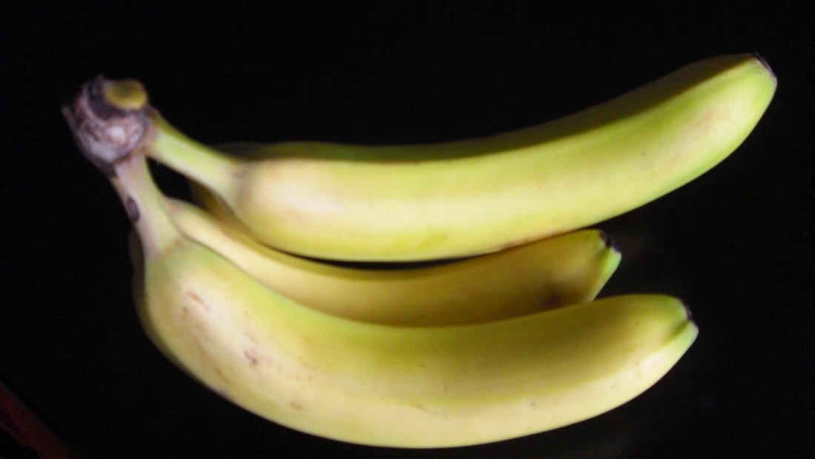
Question 12
In what food group does this food belong?

Slide 29
Answer 12
fruit

Slide 30
Question 13
Participating in _________ is a good way to stay in shape and get exercise.

Slide 31
Answer 13
sports

Slide 32
Question 14
This component in food, _______, helps your digestive track function properly.

Slide 33
Answer 14
fiber

Slide 34
Question 15
How many ounces of meats and proteins do you need each day?

Slide 35
Answer 15
five

Slide 36
Question 16
Breads and pastas are typical examples of ____________.

Slide 37
Answer 16
carbohydrates

Slide 38
Question 17
What is the smallest food group?

Slide 39
Answer 17
fats/oils

Slide 40
Question 18
What playground equipment helps build upper body strength?

Slide 41
Answer 18
monkey bars

Slide 42
Question 19
______________can prevent dehydration.

Slide 43
Answer 19
drinking plenty of water

Slide 44
Question 20
How much fruit should you eat each day?

Slide 45
Answer 20
1.5 cups

